Slide 1
WEB-BASED SECURE ROLE-BASED SYSTEM
GROUP 1
ENTERPRI
ENTERPRISE WEB SOFTWARE DEVELOPMENT SE WEB SOFTWARE DEVELOPMENT

Slide 2

INTRODUCTION
GROUP 1
This project is a web-based role-based system, in other words, it has different users who perform different function in the system.
The system is a student extenuating circumstances collecting system. The users in the system are student who submits claims, coordinator who rejects or accepts claims, manager who oversees the whole system and the administrator sets academy year and register students.

Slide 3
Members and roles
GROUP 1
Muktar Mannir– Database/Functionality
Joseph Dele – Agile Methodology
Maina Abubakar – Site Design
Ekpenyong Effiong - Testing

Slide 4
Database erd
GROUP 1

Slide 5
Db Referential integrity
GROUP 1
This is the system’s relational database concept, which states that all table relationships are always consistent.
Referential integrity is used in a different tables in the database. For instance:
Student table and EC_Claims table
The student table is where the list of
all the student details is while
EC_Claims table is where the details of
each EC_Claims posted by each student.

Slide 6
Roles implementation
GROUP 1
The application has collection of permissions/privileges that can be assigned to one or more users.
The Users of the application are
Admins
Students
EC_Coordination
EC_Manager
Each of this user has roles in the application

Slide 7
Site design (Responsive design)
GROUP 1
Responsive web design is the use of CSS and HTML to resize, hide, shrink, enlarge, or move the content of an app or website to make it look good on any screen.
Using viewport (for responsive design)
In other to get a responsive design that will run on different platform, the following line of code was added to the head section,
<linkrel="stylesheet"ref="https://maxcdn.bootstrapcdn.com/bootstrap/3.3.7/css/bootstrap.min.css"integrity="sha384BVYiiSIFeK1dGmJRAkycuHAHRg32OmUcww7on3RYdg4Va+PmSTsz/K68vbdEjh4u" crossorigin="anonymous">
And <meta name="viewport" content="width=device-width, initial-scale=1.0">
The first one is an incorporating bootstrap library and the second will help determinize how the content of the web page will fit in smaller or mobile screens.

Slide 8
Site design (usability)
GROUP 1
This system is quite easy to use given the various reasons; information is clear and not ambiguous, it runs of various screen sizes, runs on various browsers.
In a nut shell, the system is user friendly and does what it is meant to do.

Slide 9
Site design (Accessibility)
GROUP 1
Accessibility is when the website has support for physical impaired people, this is a case when the site is designed to allow any kind of user to use, anyone with disability.
But for our website, we didn’t have any support for people with disability.

Slide 10
functionality
GROUP 1
User Stories
Admin;
create student, assign password, view student information, set academy year,
Student;
add claims, add supporting document, view claims submitted, can’t delete claims, view his profile, receive notifications for decisions made on claims

Slide 11
Functionality (cont’d)
GROUP 1
User Stories
Coordinator for a faculty;
Accept claims, reject claims, sort claims according to (reject, accept, pending, late), view claims in the faculty,
Manager;
View all claims in the system (with the student info, status of claims, time accepting claims), view statistical data, exception report, scheduled report, view chart for various reports.

Slide 12
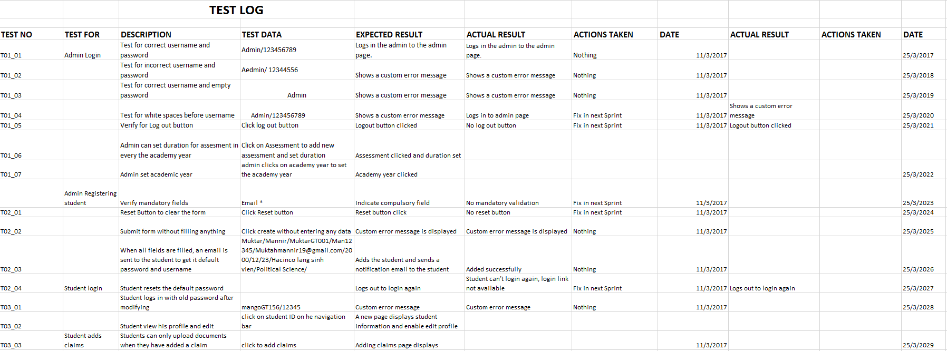
testing
GROUP 1

Slide 13
testing
GROUP 1
S/N | Test | Data Recorded | Sprint 1 | Sprint 2 | Sprint 3 | Sprint 4
1 | No of requirement | 9
2 | Average number of test per requirement | 4
3 | Total number of test cases | 40
4 | Number of test passed |  | 6 | 6 | 15 | 2
5 | Number of test failed |  | 6 | 0 | 6 | 3
6 | Total number of test executed | 40

Slide 14
Testing – Functional Requirements
The functionalities of the system are:
Admin Functions
The Admin can Add new Student to the student.
Admin can also Add closure Date for EC-Claims
Admin can Manage Academic year (add, edit, delete).
Student Functions
Students can send EC_Claims with the application
Students can upload Evidence to their claims
Students can view all their claims
Student can receive notification (via Email) of decision
Made by EC_Coordinator.

Slide 15
Testing – Functional Requirements - Cont.
Student can view their details and edit it.
EC_Coordinator Function
The major functionality of coordination in the application is to process student claims by either accepting or rejecting claims sent by students.
Manager Function
The manager can view the student EC_claims by student, claims for both accepted and not accepted
Managers can view report of everything going on the application.

Slide 16
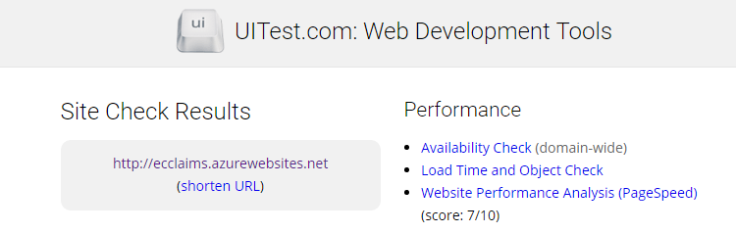
Testing – Non Functional Requirements
The following are some the the non functional requirements of the application:
Performance
Tool used – uitest.com

Slide 17
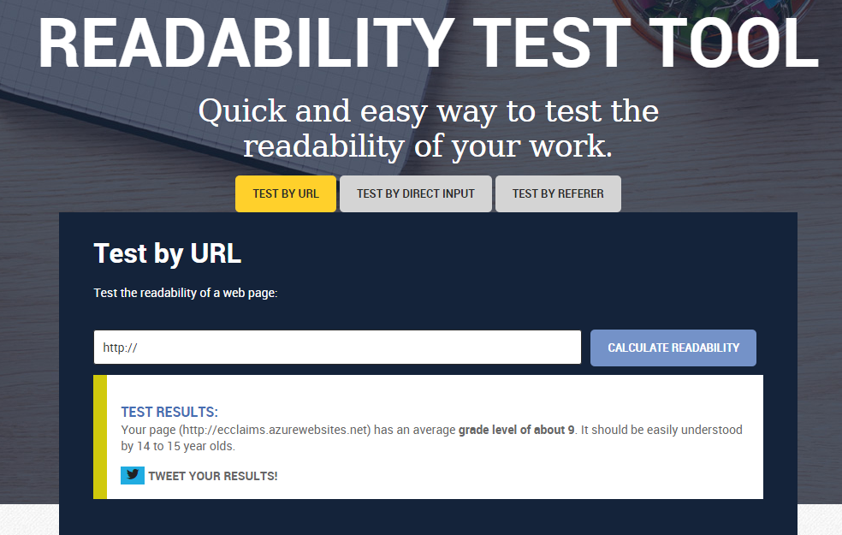
Tools: Readability test tool
Readability

Slide 18
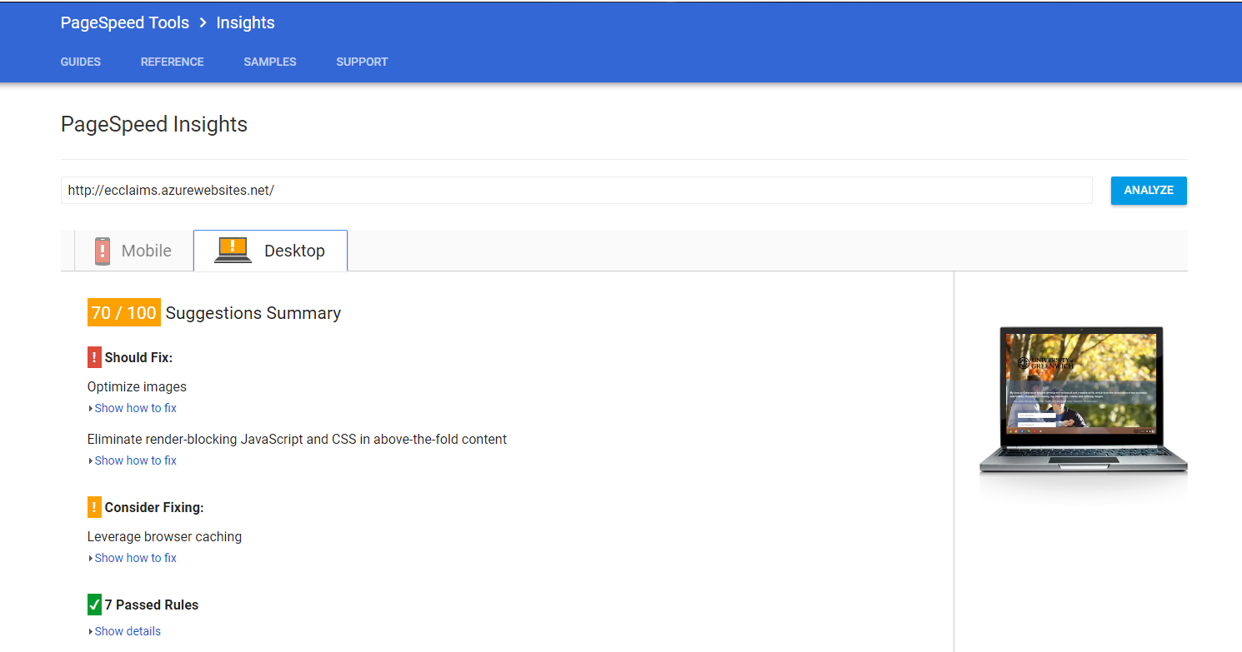
Tool Used: Google pagespeed
Speed

Slide 19
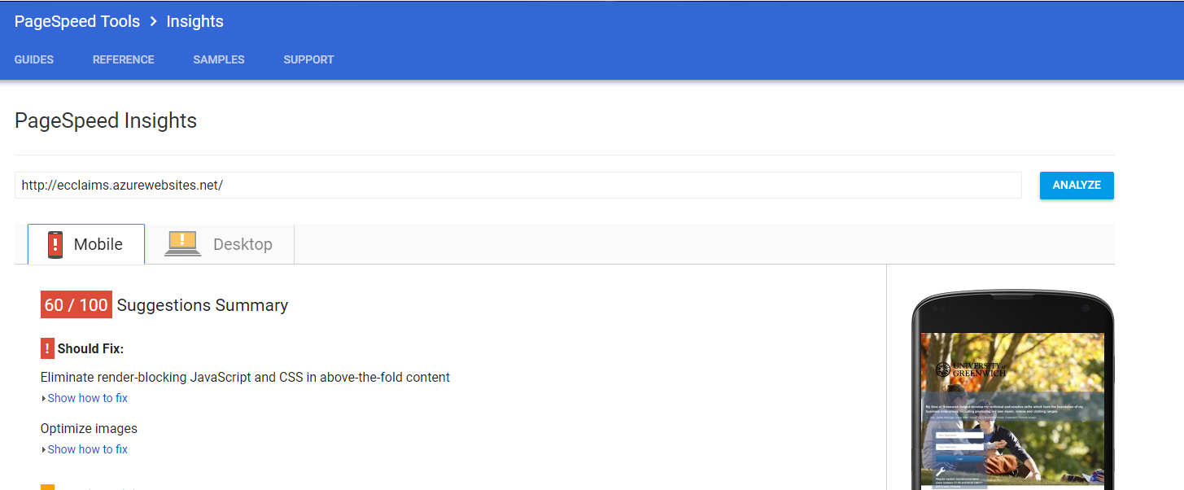
Tools Used: Google pagespeed
Mobile friendly

Slide 20
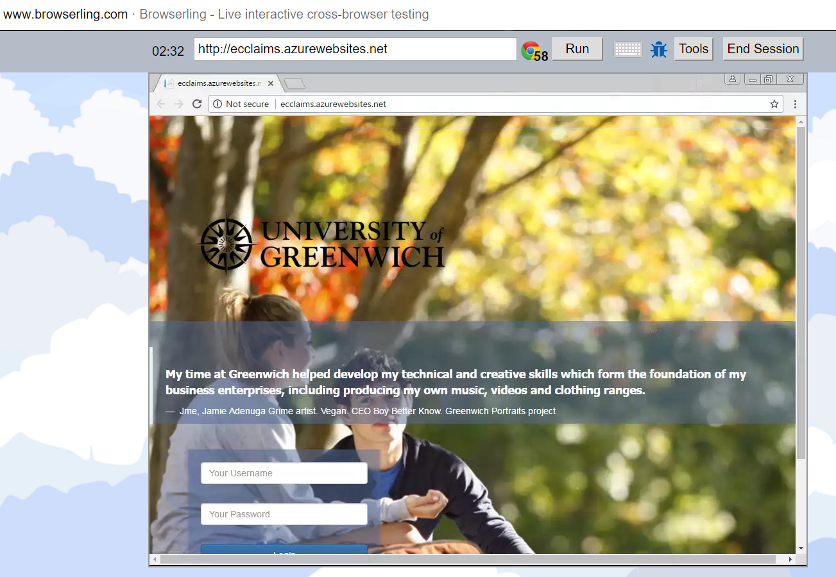
Tools used: Browserling
Cross browser – Google chrome

Slide 21
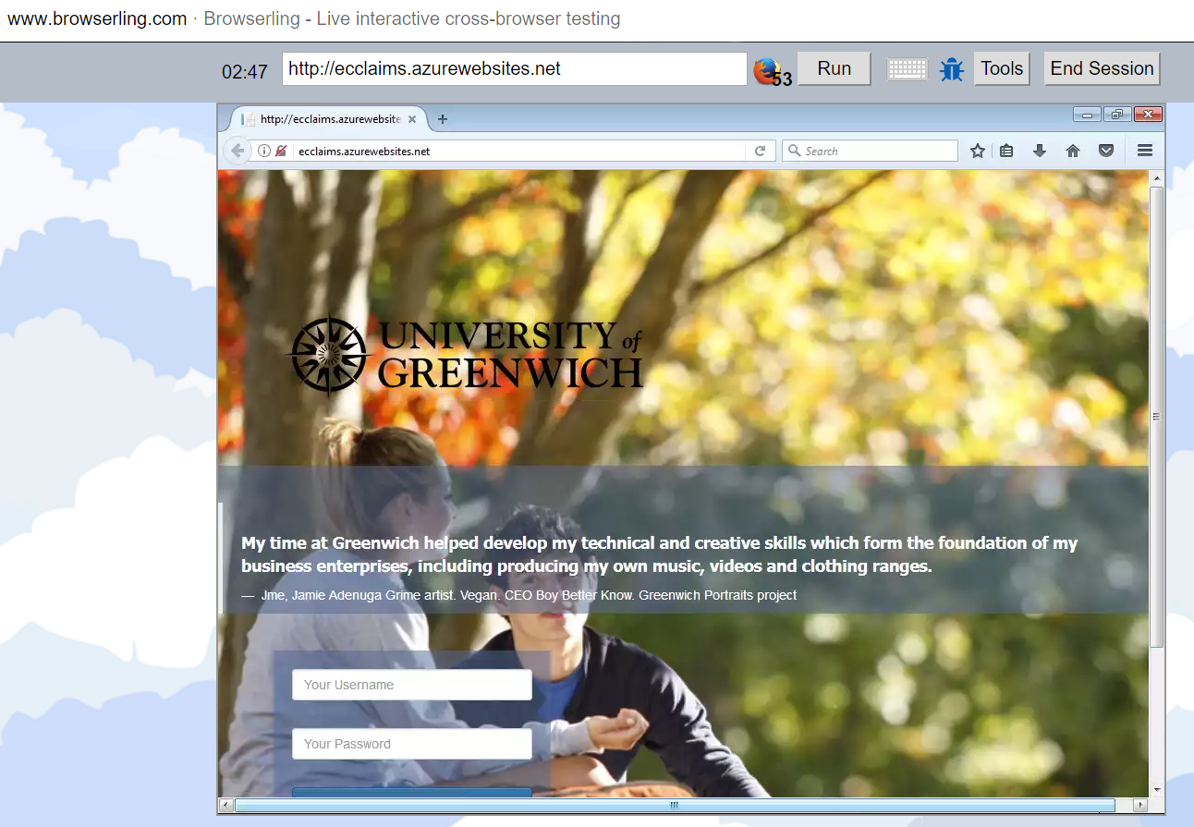
Tools used: Browserling
Cross browser: Firefox

Slide 22
Agile methodology
GROUP 1
Product Backlog;
The product backlog in a very simple term means, a list that contains everything (functionalities) that needs to be implemented in the project.
It is similar to the user story only that it further breaks down the user story into functionality.

Slide 23
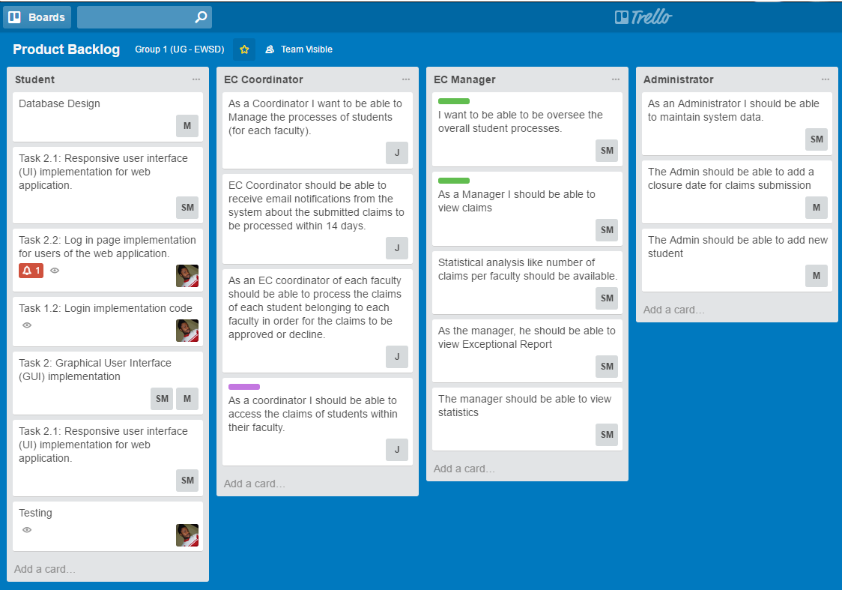
Agile methodology
GROUP 1

Slide 24
Agile methodology (cont’d)
GROUP 1
Sprint Backlog;
At every sprint, we had series of task for the product backlog broken down to simpler task in the sprint, as they are implemented, the task are moved into the finished, unfinished or in progress according to its state.

Slide 25
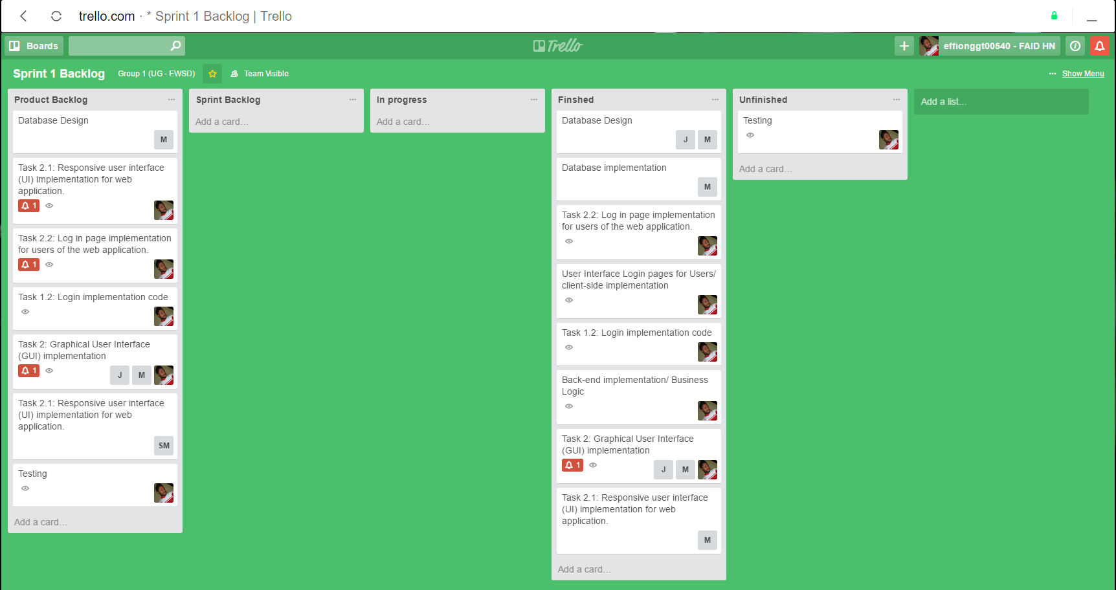
Agile methodology (cont’d)
GROUP 1

Slide 26
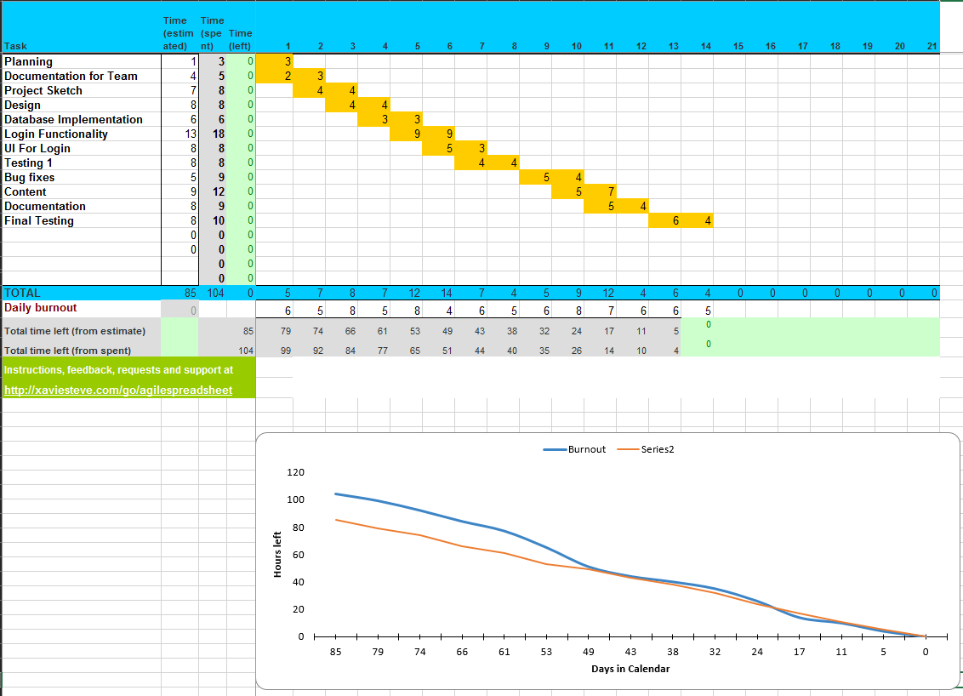
Agile methodology (Burndown)
GROUP 1

Slide 27
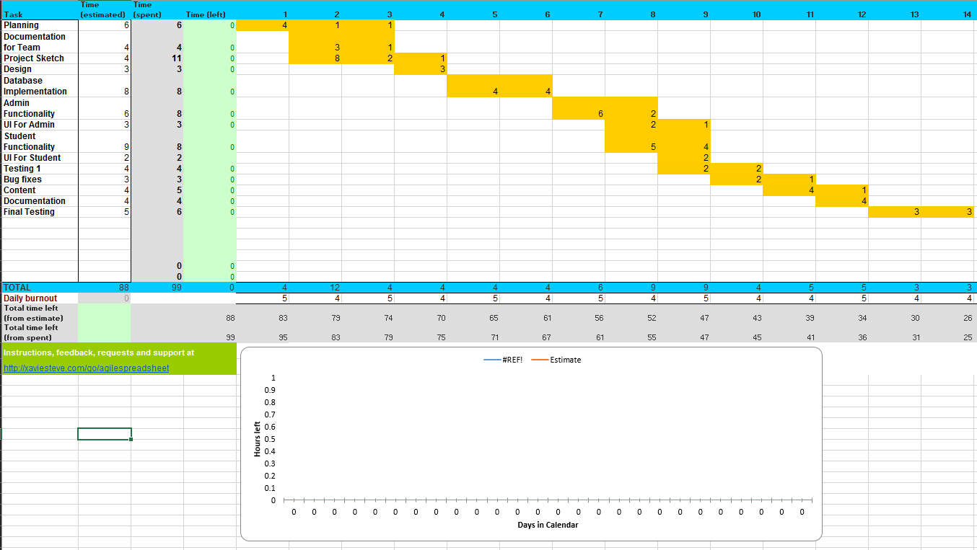
(Burndown structure sprint 2)
GROUP 1

Slide 28
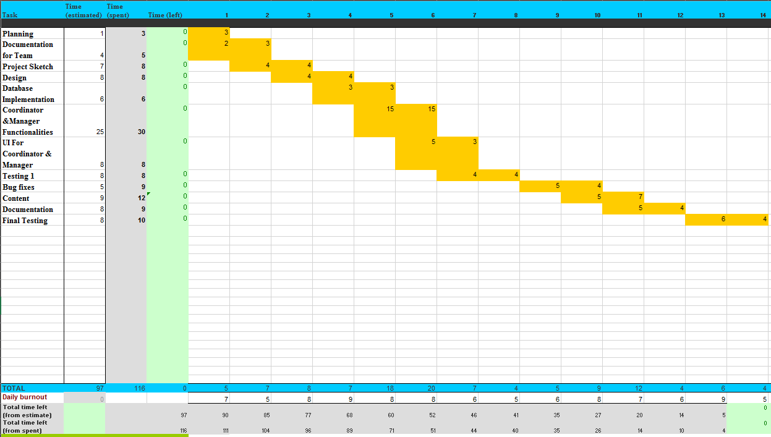
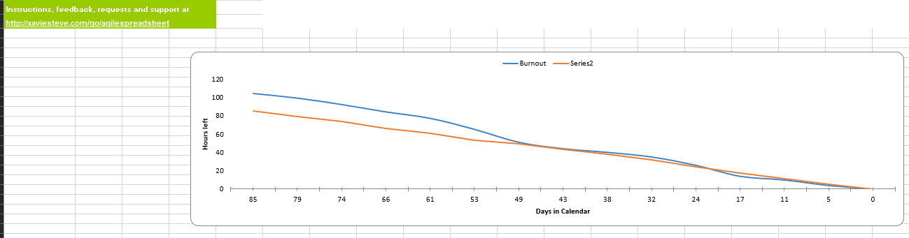
(Burndown structure, sprint 3)
GROUP 1

Slide 29
Summary of meetings
GROUP 1
We had approximately 22 meetings as recorded in our GitHub repository, here is a one of our meeting which shows attendance, purpose of meeting, goal, who’s responsible for what etc.

Slide 30
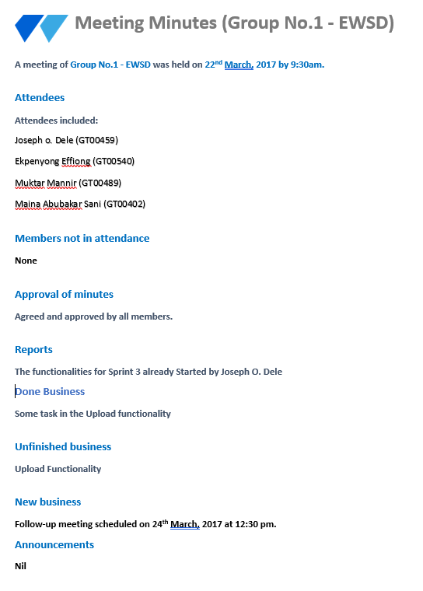
Summary of meetings
GROUP 1

Slide 31
Steps to demonstrate the system
GROUP 1
Admin; create student, assign password, view student information, set academy year,
Student; add claims, add supporting document, view claims submitted, can’t delete claims, view his profile, receive notifications for decisions made on claims
Coordinator for a faculty; accept claims, reject claims, sort claims according to (reject, accept, pending, late), view claims in the faculty,
Manager; view all claims in the system (with the student info, status of claims, time accepting claims), view statistical data, exception report, scheduled report, view chart for various reports

